Slide 1
System Studies

Slide 2
Subsystems :
We have seen the definition of a system as a set of interacting objects. The objects might be considered the basic entities of the system, but, usually, the description of a system can be made at many levels of detail.
It is customary to describe a system as consisting of interacting subsystems.
Any subsystem might, itself, be considered a system consisting of subsystems at a still lower level of detail and so on.
A system study must begin by deciding on the level of subsystem detail to be used.

Slide 3
The block-building principle helps organize a system description by isolating subsystems and identifying their inputs and outputs. Each subsystem at a given level of detail is described as a block, giving relationships between the inputs and outputs.
Each subsystem has its own inputs and outputs and, standing by itself, its response can be derived from the relationship that defines the subsystem.
The interactions that occur in a system arise from the fact that the outputs of some subsystems become the inputs of others; they become endogenous variables of the system.

Slide 4
In the same way that a system breaks down into subsystems, so also a model of a system breaks into submodels. When describing systems in terms of blocks, the term block, subsystem, or submodel tend to be used interchangeably.

Slide 5
We will illustrate the interactions that occur in a system by looking at a model of a corporation. Models of this nature are called corporate models, and they are used by many corporations to help in various aspects of planning their operations.
Their main use is in helping to understand what conditions will prevail under different sets of assumptions.

Slide 6
ENVIRONMENT
PLANT
MANAGEMENT
MAJOR SEGMENTS OF A CORPORATE MODEL

Slide 7
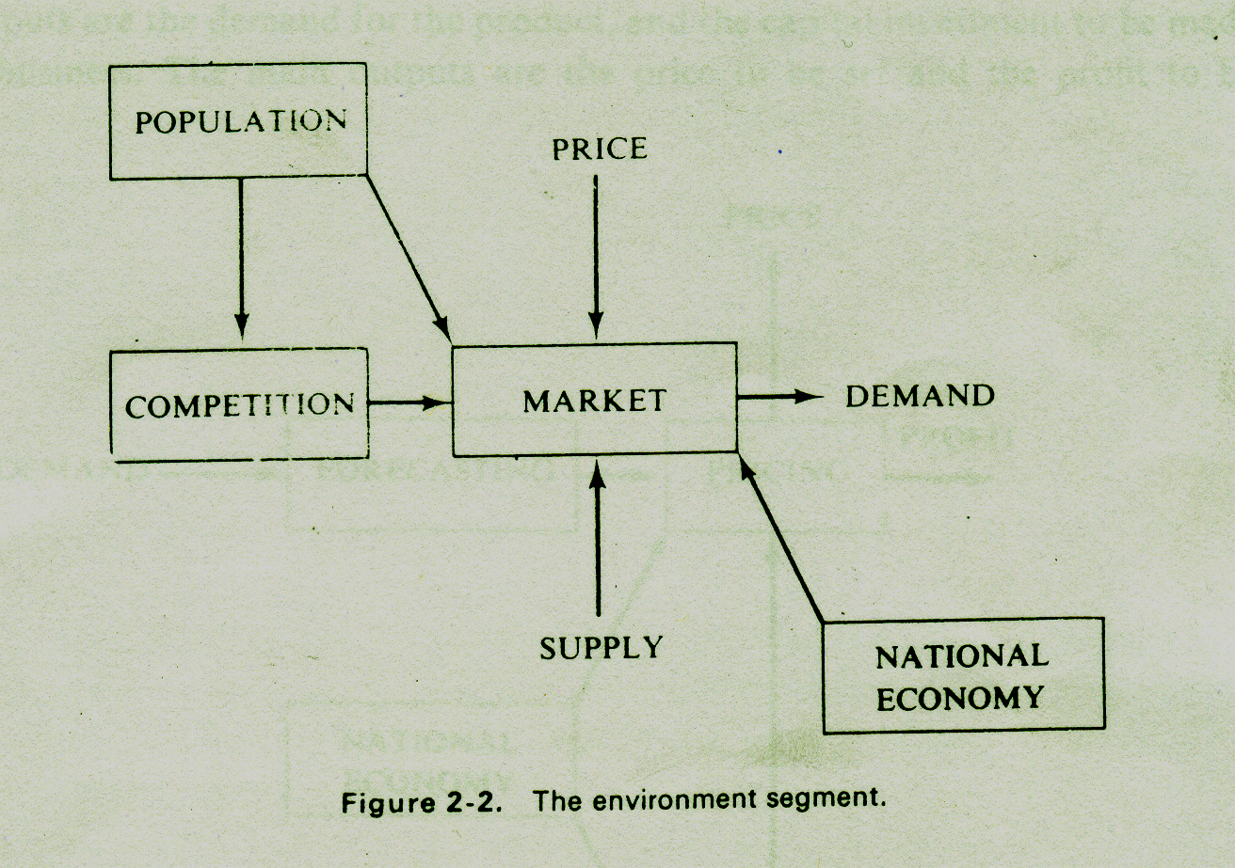

Slide 8
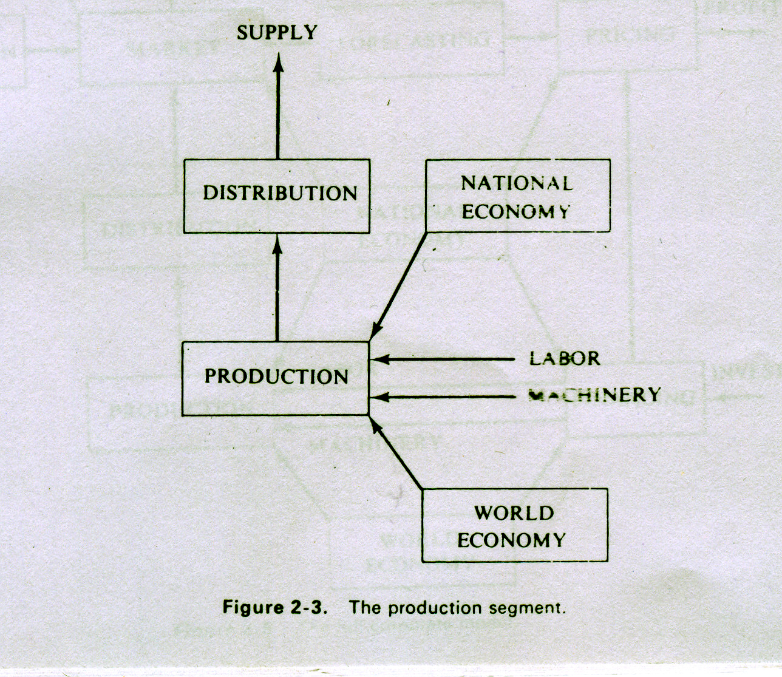

Slide 9
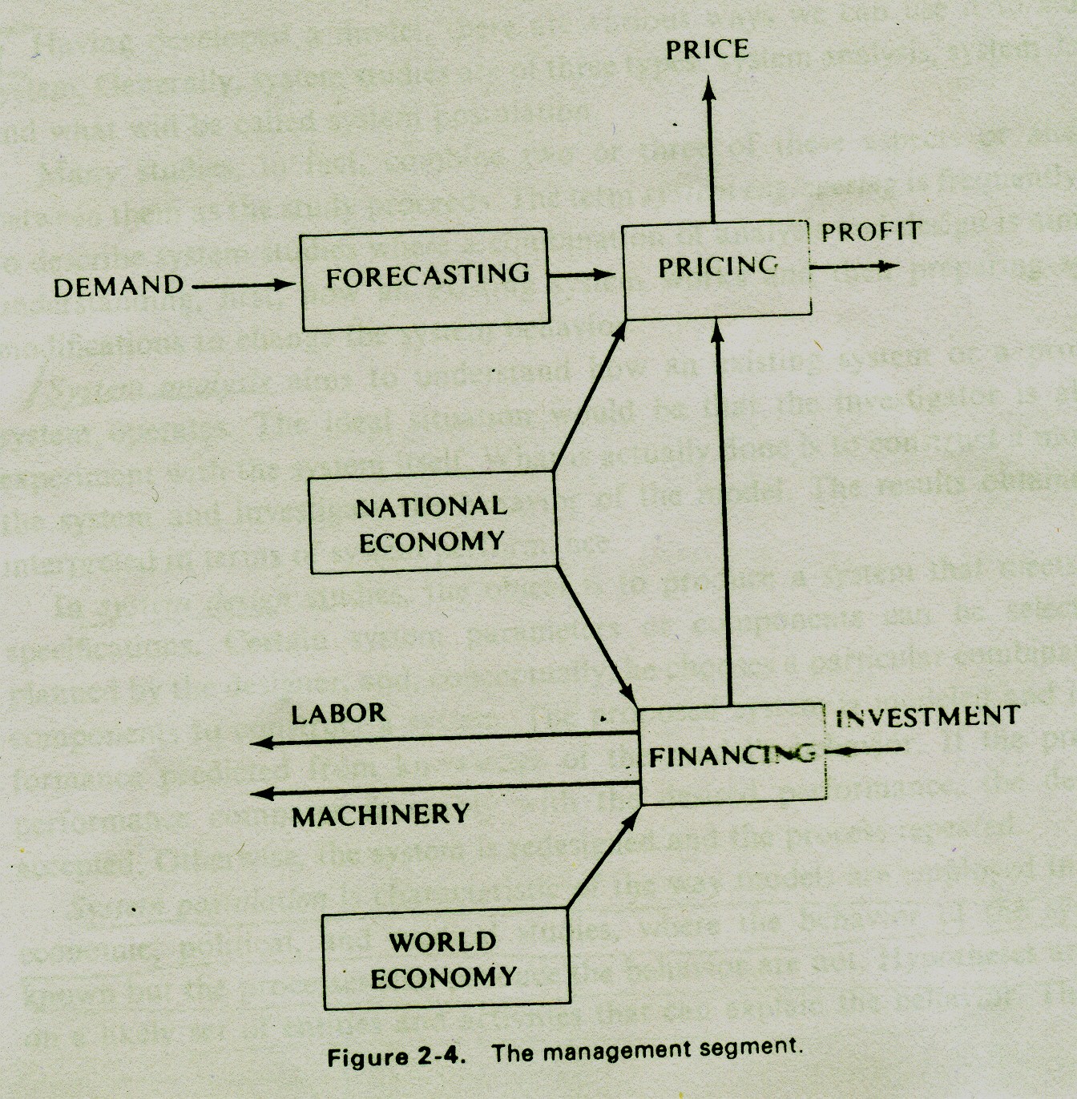

Slide 10
